Slide 1
Topic Content
Background
Presentation
Of
Marriage
By
Bikram Gyawali

Slide 2
Topic Content
Back Ground
Definition
Types/Form
General Rule
Conculsion

Slide 3
Marriage is an institution to satisfy physical, psychological, social, cultural and economic needs of men and women .It is derived from Latin word "matrimonium". The word "marriage" was first appears in 1250–1300 CE (Common Era) .
Webster
The act of uniting a man and woman for life
Alferd McClung Lee
Marriage is a public joining together under socially specified regulations of a man and a woman as husband and wife
Back Ground
Notes:
It's derived from the Latin word "mater" meaning "mother," emphasizing the role of marriage in creating a family unit. Marriage is a social institution. In general term marriage is licence which is provided by society to male and female for reproduction. Nepal has a rich and diverse cultural heritage, with various ethnic groups and communities each contributing their own traditions and customs related to marriage.Marriage is universal every society ,community and nation perform marriage .

Slide 4
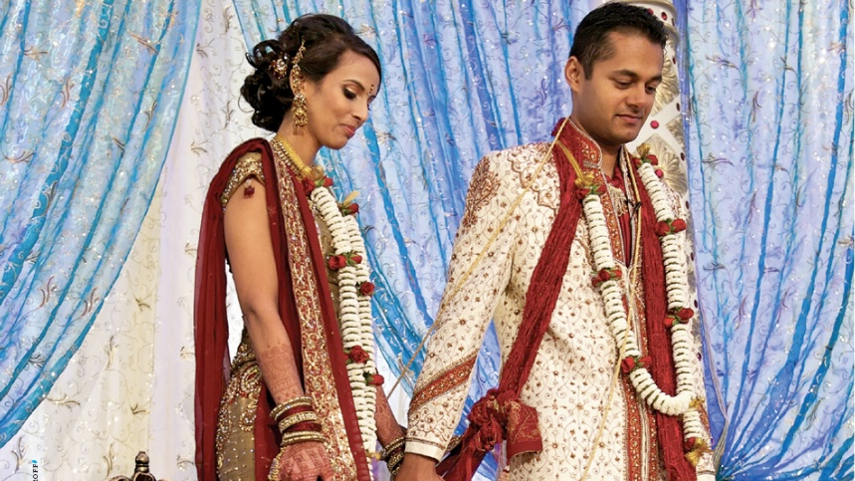
Back Ground
Marriage is an institution to satisfy physical, psychological, social, cultural and economic needs of men and women .It is derived from Latin word "matrimonium". The word "marriage" was first appears in 1250–1300 CE (Common Era) .
Notes:
It's derived from the Latin word "mater" meaning "mother," emphasizing the role of marriage in creating a family unit. Marriage is a social institution. In general term marriage is licence which is provided by society to male and female for reproduction. Nepal has a rich and diverse cultural heritage, with various ethnic groups and communities each contributing their own traditions and customs related to marriage.Marriage is universal every society ,community and nation perform marriage .

Slide 5
Malinowski
Marriage is a contract for the production and maintenance of children.
Webster
The act of uniting a man and woman for life
Definitions
Background
Marriage is an institution to satisfy physical, psychological, social, cultural and economic needs of men and women .It is derived from Latin word "matrimonium". The word "marriage" was first appears in 1250–1300 CE (Common Era) .
Alferd McClung Lee
Marriage is a public joining together under socially specified regulations of a man and a woman as husband and wife
Notes:
It's derived from the Latin word "mater" meaning "mother," emphasizing the role of marriage in creating a family unit. Marriage is a social institution. In general term marriage is licence which is provided by society to male and female for reproduction. Nepal has a rich and diverse cultural heritage, with various ethnic groups and communities each contributing their own traditions and customs related to marriage.Marriage is universal every society ,community and nation perform marriage .

Slide 6
Malinowski
Marriage is a contract for the production and maintenance of children.
Definitions
Alferd McClung Lee
Marriage is a public joining together under socially specified regulations of a man and a woman as husband and wife
Notes:
Uniting means come or bring together. Marriage are practices under certain norms and values of society like in Hindus marriage girls used to wear red sari and in Christian marry girls used to wear white clothes . Marriage is differ from society to society.

Slide 7
Malinowski
Marriage is a contract for the production and maintenance of children.
Definitions
Webster
The act of uniting a man and woman for life
Alferd McClung Lee
Marriage is a public joining together under socially specified regulations of a man and a woman as husband and wife
Notes:
Uniting means come or bring together. Marriage are practices under certain norms and values of society like in Hindus marriage girls used to wear red sari and in Christian marry girls used to wear white clothes . Marriage is differ from society to society.

Slide 8
Malinowski
Marriage is a contract for the production and maintenance of children.
Definitions
Alferd McClung Lee
Marriage is a public joining together under socially specified regulations of a man and a woman as husband and wife
Notes:
Uniting means come or bring together. Marriage are practices under certain norms and values of society like in Hindus marriage girls used to wear red sari and in Christian marry girls used to wear white clothes . Marriage is differ from society to society.

Slide 9
Major Types/Forms of Marriage
Definitions
Malinowski
Marriage is a contract for the production and maintenance of children.
Notes:
Uniting means come or bring together. Marriage are practices under certain norms and values of society like in Hindus marriage girls used to wear red sari and in Christian marry girls used to wear white clothes . Marriage is differ from society to society.

Slide 10
Major Types/Forms of Marriage
Group Marriage

Slide 11
Monogamy
Major Types/Forms of Marriage
Group Marriage

Slide 12
Major Types/Forms of Marriage
Monogamy
Group Marriage
Experimental Marriage

Slide 13
Major Types/Forms of Marriage
Monogamy
Group Marriage
Experimental Marriage

Slide 14
Group Marriage
Group marriage is a type of marriage where multiple people are married to each other at the same time, forming a single marital unit
Notes:
For example, imagine a family where John is married to Natasha, but Natasha is also married to Mike and Emily. John is also married to Mike and Emily. So, in a group marriage, everyone is married to everyone else in the group. Group marriage is mainly practices in the hunting and gathering society. Now a day group marriage is not in practices in modern society.

Slide 15
Polyandry
Fraternal Polyandry
Non-Fraternal Polyandry
Polygamy
Sororal Polygamy
Non-Sororal Polygamy
Group Marriage
Group marriage is a type of marriage where multiple people are married to each other at the same time, forming a single marital unit
Types Of Group Marriage
Notes:
For example, imagine a family where John is married to Natasha, but Natasha is also married to Mike and Emily. John is also married to Mike and Emily. So, in a group marriage, everyone is married to everyone else in the group. Group marriage is mainly practices in the hunting and gathering society. Now a day group marriage is not in practices in modern society.

Slide 16
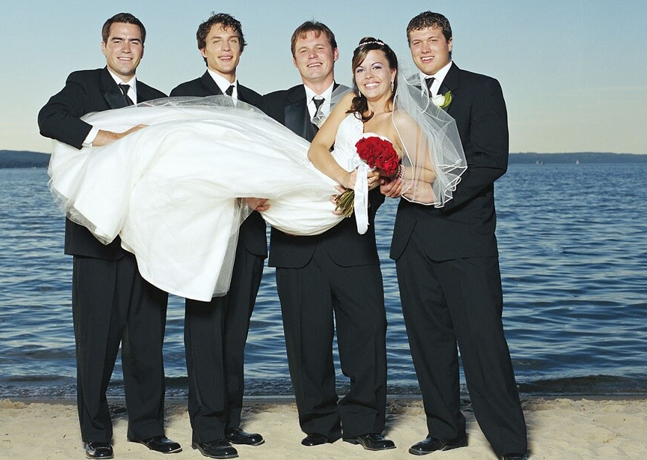
Polyandry
Polyandry is a form of marriage in which a woman has multiple husbands at the same time. Indigenous cultures in the Himalayan religion, such as Tibetans and the Naxi people of China practiced this type of marriage
Notes:
Polyandry marriage is just opposite of Polygamy. Polyandry can be caused by factors such as , less number of women scarcity of resources (like land or food), where having multiple husbands helps ensure economic stability. It can also be a cultural practice, where societal norms or religious beliefs support the idea of a woman having multiple husbands.

Slide 17
Polyandry
Polyandry is a form of marriage in which a woman has multiple husbands at the same time. Indigenous cultures in the Himalayan religion, such as Tibetans and the Naxi people of China practiced this type of marriage
Notes:
Polyandry marriage is just opposite of Polygamy. Polyandry can be caused by factors such as , less number of women scarcity of resources (like land or food), where having multiple husbands helps ensure economic stability. It can also be a cultural practice, where societal norms or religious beliefs support the idea of a woman having multiple husbands.

Slide 18
Fraternal Polyandry
Types of Polyandry
Notes:
In non-fraternal polyandry if a children is born then one husband is chosen by the woman for social parenting . Both of them are consider as a parents of that children and they are responsible for the basic need and growth of him

Slide 19
Types of Polyandry
Fraternal polyandry is a form of polyandry where a woman is married to two or more brothers of the same household at the same time. This practice is found in some cultures, particularly in the Himalayan region and parts of India
Notes:
In non-fraternal polyandry if a children is born then one husband is chosen by the woman for social parenting . Both of them are consider as a parents of that children and they are responsible for the basic need and growth of him

Slide 20
Non-fraternal Polyandry
Types of Polyandry
Non-fraternal polyandry is a form of polyandry where a woman is married to multiple men who are not brothers.
It was practices by 'Malay' tribe.
Notes:
In non-fraternal polyandry if a children is born then one husband is chosen by the woman for social parenting . Both of them are consider as a parents of that children and they are responsible for the basic need and growth of him

Slide 21
Polyandry
Fraternal Polyandry
Non-Fraternal Polyandry
Polygamy
Sororal Polygamy
Non-Sororal Polygamy
Group Marriage
Group marriage is a type of marriage where multiple people are married to each other at the same time, forming a single marital unit
Types Of Group Marriage
Notes:
For example, imagine a family where John is married to Natasha, but Natasha is also married to Mike and Emily. John is also married to Mike and Emily. So, in a group marriage, everyone is married to everyone else in the group. Group marriage is mainly practices in the hunting and gathering society. Now a day group marriage is not in practices in modern society.

Slide 22
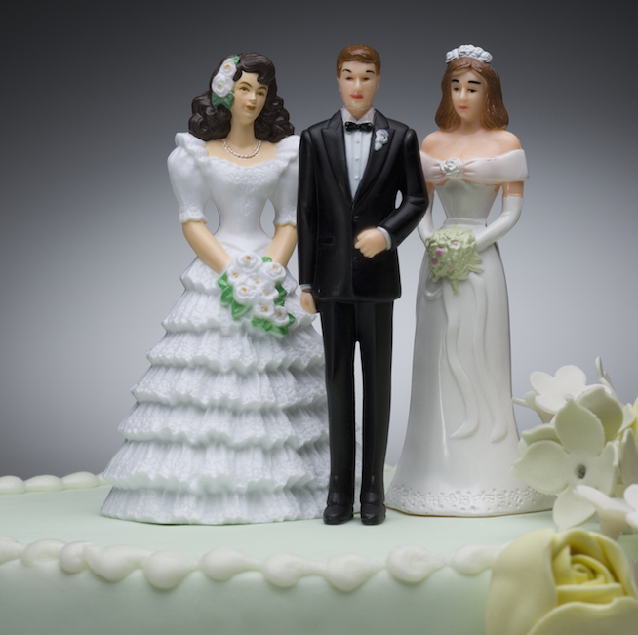
Polygamy
Polygamy is a form of marriage in which one man marriage more than one woman at a given time.
King Pratap Singh Shah had 32 wives.
Notes:
It is opposite than polyandry .Some of the many reasons as to why polygamy is practiced are to uphold the cultural traditions, economic considerations, and social status. In other societies, having more than one wife was considered to fulfill the purposes of a large family which would mean more hands to labor in the farm or other works

Slide 23
Polygamy
Polygamy is a form of marriage in which one man marriage more than one woman at a given time.
King Pratap Singh Shah had 32 wives.
Notes:
It is opposite than polyandry .Some of the many reasons as to why polygamy is practiced are to uphold the cultural traditions, economic considerations, and social status. In other societies, having more than one wife was considered to fulfill the purposes of a large family which would mean more hands to labor in the farm or other works

Slide 24
Sororal Polygamy
Types of Polygamy
Notes:
Reason to cause sororal polygamy can help in the preservation of family wealth and property, as it keeps assets within the family.
Reason to cause non-sororal polygamy having multiple wives was often seen as a sign of wealth and power.it was practices for economic advantage , for social and biological reason.

Slide 25
Types of Polygamy
Sororal polygamy is a form of polygamy in which a man marries multiple women who are sisters of same household.
Notes:
Reason to cause sororal polygamy can help in the preservation of family wealth and property, as it keeps assets within the family.
Reason to cause non-sororal polygamy having multiple wives was often seen as a sign of wealth and power.it was practices for economic advantage , for social and biological reason.

Slide 26
Non-Sororal Polygamy
Types of Polygamy
Non-sororal polygamy refers to a form of polygamy where a man is allowed to marry multiple women who are not sisters.
Notes:
Reason to cause sororal polygamy can help in the preservation of family wealth and property, as it keeps assets within the family.
Reason to cause non-sororal polygamy having multiple wives was often seen as a sign of wealth and power.it was practices for economic advantage , for social and biological reason.

Slide 27
Major Types/Forms of Marriage
Monogamy
Group Marriage
Experimental Marriage

Slide 28

Monogamy
Monogamy is a form of marriage in which one man marriages one women at a time. This type of marriage is universally accepted.
Notes:
Monogamy offers a stable environment for a child simply because both parents are usually involved in the raising of the children. It also entails a deeper feeling of emotional support and intimacy. According to great Greek Scholar Aristotal Monogamy help to empower women and Control population

Slide 29
General Rule of Marriage
Monogamy
Monogamy is a form of marriage in which one man marriages one women at a time. This type of marriage is universally accepted.
Notes:
Monogamy offers a stable environment for a child simply because both parents are usually involved in the raising of the children. It also entails a deeper feeling of emotional support and intimacy. According to great Greek Scholar Aristotal Monogamy help to empower women and Control population

Slide 30

Major Types/Forms of Marriage
Monogamy
Group Marriage
Experimental Marriage

Slide 31

Experimental Marriage
Experimental marriage is a type of marriage where partners agree to a trial period to see if they are compatible before committing to a permanent relationship.
Notes:
We can simply say it living together.
There are many other form of marriage which are practices in our society such as Anuloma(a form of inter caste marriage in which a men of higher caste marriage a lower caste women)
Protiloma ( lower caste boy and higher caste girl) and many other

Slide 32
Monogamy
Experimental Marriage
Experimental marriage is a type of marriage where partners agree to a trial period to see if they are compatible before committing to a permanent relationship.
Notes:
We can simply say it living together.
There are many other form of marriage which are practices in our society such as Anuloma(a form of inter caste marriage in which a men of higher caste marriage a lower caste women)
Protiloma ( lower caste boy and higher caste girl) and many other

Slide 33
General Rule of Marriage
Endogamy Marriage
Notes:
Marriage is a social institution so there are cetain rules and regulation which are made by society regarding 'who should marry whom'. In every culture there are many norms and values which affect the marriage. Marriage differ from culture to culture.

Slide 34
Exogamy
Marriage
General Rule of Marriage
Endogamy Marriage
Notes:
Marriage is a social institution so there are cetain rules and regulation which are made by society regarding 'who should marry whom'. In every culture there are many norms and values which affect the marriage. Marriage differ from culture to culture.

Slide 35
General Rule of Marriage
Exogamy
Marriage
Endogamy Marriage
Notes:
Marriage is a social institution so there are cetain rules and regulation which are made by society regarding 'who should marry whom'. In every culture there are many norms and values which affect the marriage. Marriage differ from culture to culture.

Slide 36
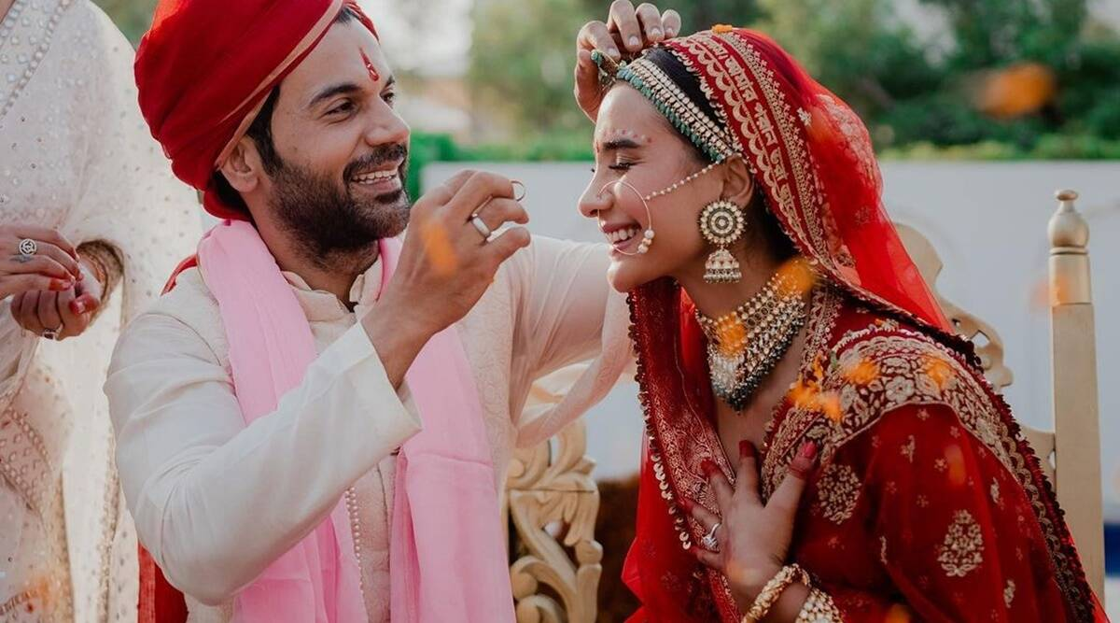
Endogamy Marriage
Endogamy is when people marry within their own social, cultural, or ethnic group, often as a way to preserve traditions, values, or social status.
Notes:
Example of Endogamy is Hindus marry with Hindu ,Muslim with Muslim ,etc. Therefore, endogamy ensures that the marry in a particular cultural traditions helps to protects wealth or family status, and increases social bonding within the community.

Slide 37
Exogamy
Endogamy Marriage
Endogamy is when people marry within their own social, cultural, or ethnic group, often as a way to preserve traditions, values, or social status.
Notes:
Example of Endogamy is Hindus marry with Hindu ,Muslim with Muslim ,etc. Therefore, endogamy ensures that the marry in a particular cultural traditions helps to protects wealth or family status, and increases social bonding within the community.

Slide 38
General Rule of Marriage
Exogamy
Marriage
Endogamy Marriage
Notes:
Marriage is a social institution so there are cetain rules and regulation which are made by society regarding 'who should marry whom'. In every culture there are many norms and values which affect the marriage. Marriage differ from culture to culture.

Slide 39
Exogamy is a marriage rule that requires individuals to marry outside of their own social group, family, or clan. In Nepal Inter caste marriage is an example of Exogamy.
There are several types of exogamy such as caste exogamy, geographical exogamy, religious exogamy, clan exogamy.
Exogamy
Notes:
In Brahmin and Chettri clan (gotra) exogamy marriage is strictly practiced. Exogamy marriage help to increase social Diversity , maintain good relationship among different social groups .

Slide 40
Exogamy
Conclusion
Exogamy is a marriage rule that requires individuals to marry outside of their own social group, family, or clan. In Nepal Inter caste marriage is an example of Exogamy.
There are several types of exogamy such as caste exogamy, geographical exogamy, religious exogamy, clan exogamy.
Notes:
In Brahmin and Chettri clan (gotra) exogamy marriage is strictly practiced. Exogamy marriage help to increase social Diversity , maintain good relationship among different social groups .

Slide 41
Each Community ,society has its own marriage system. Love marriage , inter caste marriage , living together types of marriage are increase day by day. Marriage is dynamic and diverse in nature.
Conclusion
Notes:
Some of the factors which affect marriage are education , urbanization , migration ,economic opportunities . Due to urbanization and influence of western culutre in Nepal the concept of marriage is change. Some year ago after the death of husband the wife can't do another marriage but now she can. The concept of divorce is change into 'yekal mahila'.

Slide 42

Any Question
Conclusion
Each Community ,society has its own marriage system. Love marriage , inter caste marriage , living together types of marriage are increase day by day. Marriage is dynamic and diverse in nature.
Notes:
Some of the factors which affect marriage are education , urbanization , migration ,economic opportunities . Due to urbanization and influence of western culutre in Nepal the concept of marriage is change. Some year ago after the death of husband the wife can't do another marriage but now she can. The concept of divorce is change into 'yekal mahila'.

Slide 43
Any Queries
Thank
You

Slide 44
Any Queries
Thank
You

